Slide 1


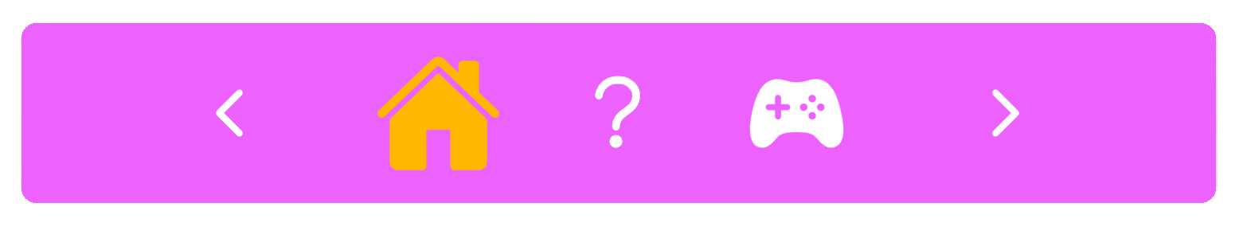
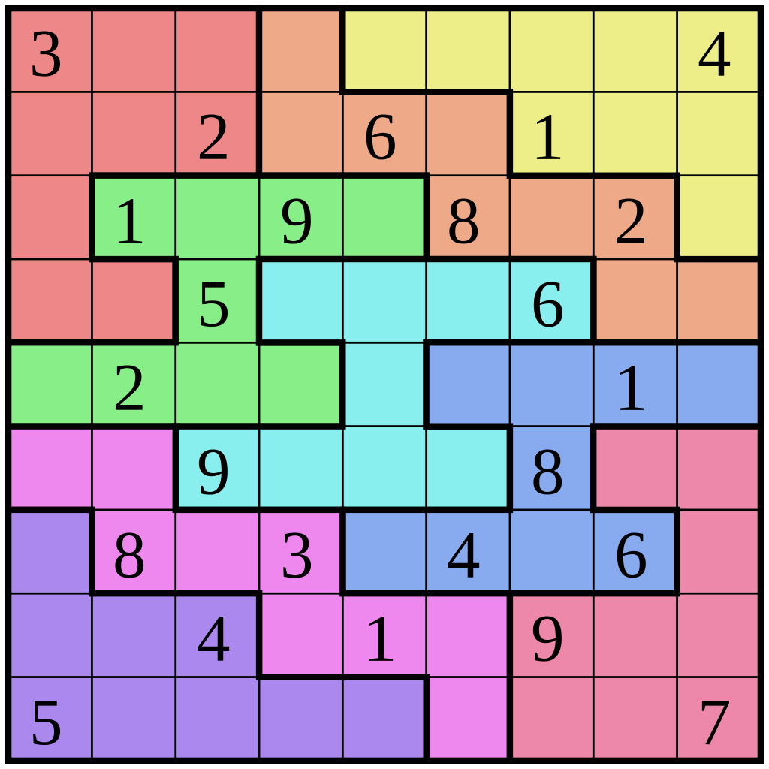
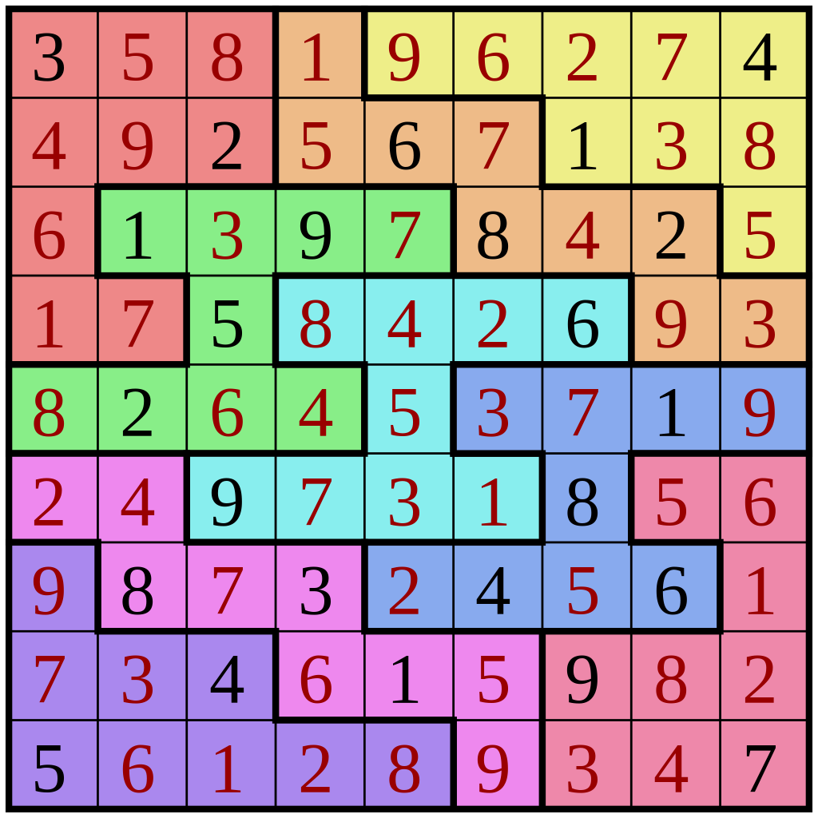
Project Kuduoopo An Online Sudoku Minigame Web
What is Sudoku? And How To Play?
In short “sudoku” basically is a number puzzle. The rules for sudoku are simple. A 9×9 square must be filled in with numbers from 1-9 with no repeated numbers in each line, horizontally or vertically.
Group members:
01157154 田馬太 & 01157056 鄭有昇
Refer to: https://en.wikipedia.org/wiki/Sudoku

Slide 2
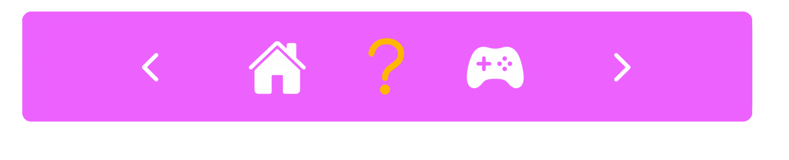
What is Sudoku in general?
In short “sudoku” basically is a number puzzle. The rules for sudoku are simple. A 9×9 square must be filled in with numbers from 1-9 with no repeated numbers in each line, horizontally or vertically.
Refer to: https://en.wikipedia.org/wiki/Sudoku
About this project
This project is specially created for the final project. Our vision was to help people understanding the gameplay of sudoku. Most of us were probably never even played sudoku, but in fact it is a very simple game that you can play just to pass the time.
In this case we will try to add a new type of sudoku game, so the gameplay can be more enjoyable. User can also select between the normal or the other unique gamemodes that we created.

Slide 3
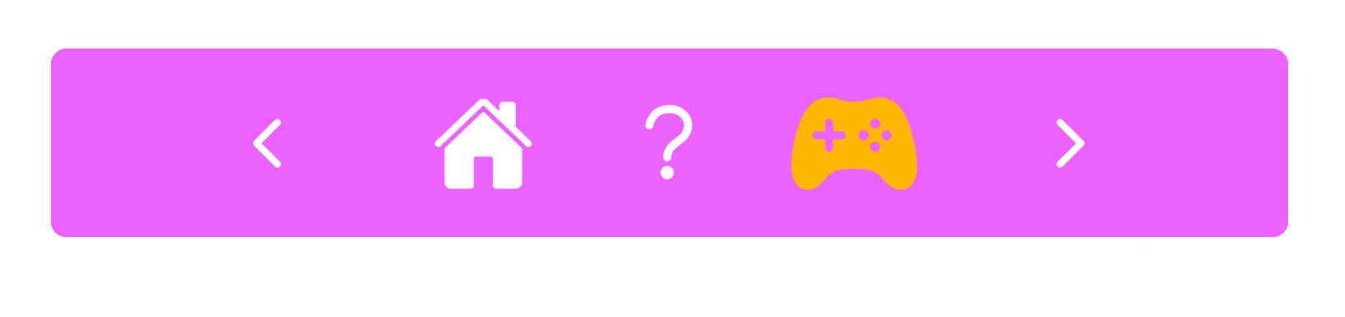

What is Sudoku? And How To Play?
In short “sudoku” basically is a number puzzle. The rules for sudoku are simple. A 9×9 square must be filled in with numbers from 1-9 with no repeated numbers in each line, horizontally or vertically.
Refer to: https://en.wikipedia.org/wiki/Sudoku
About this project
This project is specially created for the final project. Our vision was to help people understanding the gameplay of sudoku.
In this case we will try to add a new type of sudoku game, so the gameplay can be more enjoyable. User can also select between the normal or the other unique game modes that we’ve created.
Our title Kuduoopo originated from Javanese language “Kudu opo?” which means “what to do?”, so in order to do something to pass the time we can play sudoku, by playing we are also training our brain to become sharper and quicker.
Our Website Project in General
For the big part we will stick to the idea of implementing the original game itself. But we will try to introduce a new type of gamemodes, so that the gameplay can be more fun.
Most people play sudoku on a paper, but hopeful by making it online on a website based game, we can bring an easier access for people to play sudoku anywhere.

Slide 4
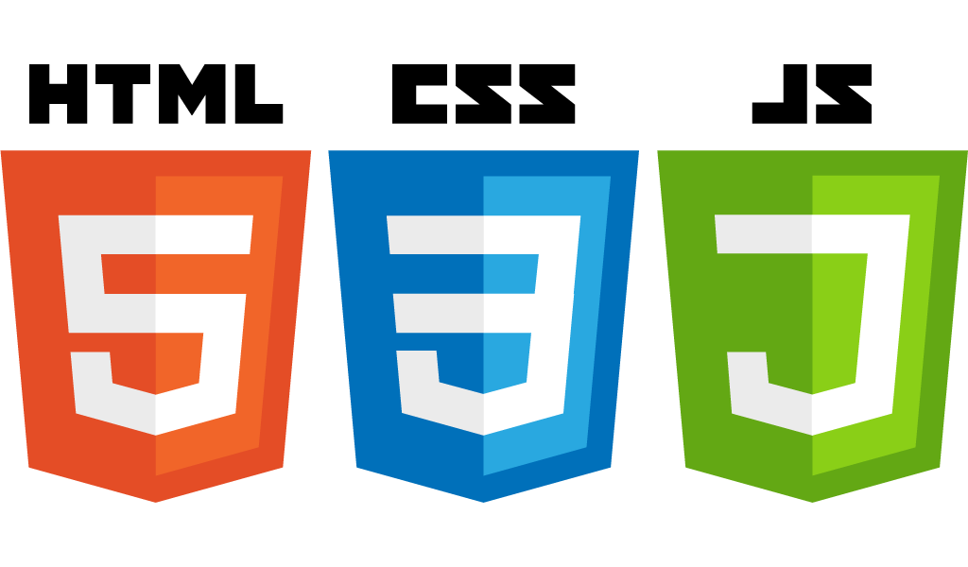



Our Website Project in General
Program Language Implementation
For the big part we will stick to the idea of implementing the original game itself. But we will try to introduce a new type of gamemodes, so that the gameplay can be more fun.
Most people play sudoku on a paper, but hopeful by making it online on a website based game, we can bring an easier access for people to play sudoku anywhere.
Game Selection
Game Play
Information Page
For our website we are implementing basic web program language which includes HTML and CSS for the website structure, then JavaScript for the server side programming.
We also use jQuery and css doodle library for simple animation features that makes the website more attractive.
We also use the local storage to save the user data a json files, so we are relying on client side communication to send and retrieve data.
Store the player’s time and score
Game Page
Display time and score after the game is finished

Slide 5
Workload Division
鄭有昇(Freddy)
田馬太(Alex)
Web UI Designs
Web Structure
Game mode Section page
Power Points
Web UI Designs
jQuery and CSS animations
Assets
Web functionality
Home, Help, & Game selection page

Slide 6
(Main Title)
Program Language Implementation
Game Selection
Game Play
In this case, we planned to use HTML, CSS, and JavaScript.
HTML and CSS will be used for front-end designing the website interfaces and structure, meanwhile JavaScript will be used as the server side backend. We hope by using this program language we would be able to understand more of how web programming language is implemented in daily task.
Information Page
Home Page
Store the player’s time and score
Game Page
Display time and score after the game is finished
Web Flowchart

Slide 7
Key Issues
Some website has a different default layout style, so some animation might not appear the same on each website (such as scrollbar animation, button style, alert window, etc…). There is no way to counter this issue as the website default setting prevent you from modifying their own layout for security reasons.

Slide 8
Essential Links
https://github.com/alexMSeal/Project-Kuduoopo.git
(GitHub source code)
https://alexmseal.github.io/Project-Kuduoopo/
(Live server demo)

